Slide 1
Refugees and the Macro Sociopolitical context
Paul Scholes- University of North Carolina at Charlotte
pscholes@uncc.edu

Slide 2
Overview
Refugees
Research question
Theoretical Background
Hypotheses
Analysis
Discussion

Slide 3
Refugees
79.5 million displaced individuals at the end of 2019(United Nations High Commissioner for Refugees 2020)
26.0 million refugees, the highest ever seen.
Since 1975, the US has resettled 3.2 million refugees
Migration can be economic, familial, forced, etc.
Notes:
Thus, refugees are a form of forced migration, and shouldn’t be confused with those who migrate to improve their situation. Migrants who flee climate change, poverty, or other factors not mentioned in the definition are not refugees under this United Nations label.

Slide 4
Refugees in the US
Most typical route: Refugees submit an application to the UN. Then they need to pass several rounds of interviews and background checks from at least six U.S. agencies before resettlement in to the U.S.
They are assigned to one of nine agencies, which work with the U.S. Department of State. Then these agencies assign the case to one of the local offices for resettlement.
Financial assistance use is high at first but drops drastically in the first few years.
Notes:
THE PROCESS
UNHCR collects initial documentation and biographical information-> Department of State Resettlment Center, an indepth interview, verifies data, and send for background check-> National Counter-terrorism center, FBI, Department of Homeland Security, Department of Defense, Department of State and the intelligence community screen applicant. Refugees are screened more carefully than any other traveler in the US.
Results from each agency are transmitted back to Department of Homeland Security, conduct in person interviews and collect biometric data. DHS confirms this interview with first interview. Additional interviews are scheduled and verified afterwards. Inconsistencies put a case on hold, new information puts a case on hold. DHS makes a decision. Biometric data is screened against DOD, FBI and DHS databases.-> Cultural orientation class and Medical check-> Each week 9 resettlement agencies meet and review applicant info to determine settlement location.
Refugees are then further assigned to a local office/partner for a specific area picked for the individual refugee. Considerations include whether the refugee has family in the area, the presence of a similar ethnic group, training programs that fit the refugee’s interests and needs, cost of living, amount and size of affordable housing units available, job availability, or the presences of housing that fits specific needs (Hirsch 2020). For the first few months, refugees are given substantial assistance. After this preliminary time period (the earliest time limit is 8 months), refugees typically no longer qualify for refugee specific programs and rely on standard American programs like the Supplemental Nutrition Assistance Program (SNAP) or Medicaid. Refugees are eligible for typical American assistance programs for at least 5 years, the states have extremely different limitations and eligibility requirements but no state cuts refugees off before five years (Fix, Hooper, and Zong 2017).
The percentage of refugees needing assistance decreases dramatically after the first few years of arrival in the U.S. and continues to drop steadily as they gain more years of residency. Refugees typically pay more in taxes than they receive in benefits over their first 20 years (Evans and Fitzgerald 2017). Refugee men are more likely to be employed than native men. Refugee women are about equally as likely as native women to be employed (Fix, Hooper, Zong 2017).
MY RESEARCH QUESTIONS: How many refugees in the United States can be financially independent? How has this changed over time? Have we seen any large changes associated with the recent events surrounding migrants and refugees?

Slide 5
Research Question
What are the effects of the Trump administration’s policies on refugee financial independence?
How does refugee financial independence change from 2000-2017?
How does refugee dependence on public assistance programs change from 2000-2017?

Slide 6
Background
Strang and Ager (2010), see refugee integration as a two way negotiation between host contexts and refugees.
Employment, English language ability, enrollment in training or education programs are both creators and manifestations of social capital
Burt (1992) “Social capital is the friends, colleagues, and more general contacts through whom you receive opportunities to use your financial and human capital”
Discourse on refugees and arrival of refugees can change how people perceive/treat refugees. (Esses, Medianu, and Lawson 2013; Phillimore 2020)
Notes:
***Burt (1992) “Social capital is the friends, colleagues, and more general contacts through whom you receive opportunities to use your financial and human capital”
“Existing work in these areas tends to be largely qualitative, consisting of small samples, focused at the micro level, and examining outcomes for specific ethnonational groups with little attention to refugee needs. No systematic investigation has yet been undertaken of how these opportunity structures, individually or intersectionally, shape refugee integration and thus they offer the possibility of a new direction for research around refugee integration that is truly multidimensional.” (Phillimore 2020)

Slide 7
Applying Legitimacy Theory
The macro and micro contexts are engaged in a Gramscian (1971) war of position for hegemony
I’ll focus on the political contexts, the media, and the local communities in this theoretical analysis
The Media is both participant and battlefield in this war of position.
Domination
Equity Theory
The spread of validity
Notes:
Refugees are placed into a new situation that they have no experience with and thus cannot determine if collective support is present or absent. The social learning from their experiences and lack of resources may make refugees more likely to assume an inferior position, especially considering equity theory (Della Fave 1980). This may enable host context actors to take advantage over refugees, especially in indifferent or hostile milieu.

Slide 8
Co-Dependence of macro and micro structures in U.S.
All structures rely on the endorsement of their constituents.
Especially true for macro structures like political groups or media networks.
Micro structures rely on funding and guidance of macro structures (especially in refugee resettlement)
Processes of Authorization and endorsement run both ways.
Legitimization processes usually occur without your knowledge and without your belief in them.

Slide 9
Refugee stories in the media and legitimization
Three types of stories told about refugees and migrants in the media
Enemy at the Gates
The Good Migrant
Abuse of the System
Notes:
The media legitimizes via 1) authorization—as they give select certain experts to give a platform—and 2) endorsement—as they interview everyday people, or cite American survey data from Pew or Gallop research centers.
Enemy at the gates type stories serve to influence the political and local contexts to change policy. When a caravan of migrants is on its way to the boarder, Americans worry about disease, crime, and impact on the local economy.
Stories about the good migrant always start with migrants who do things the right way: they obey, work long hours, have families, and express love for the United States. The messages are 1) sometimes aimed at the local or political contexts to humanize the struggle of migration, but 2) these stories are always messages to migrants about how to be a good migrant. The political context, the local context, and the immigrants themselves will compare their performance to this “ideal migrant” role presented by the media.
These stories of system abuse by migrant or refugees perform two roles 1) they delegitimize the resource shares of the target, and 2) they ensure that those with few resources never have the share of resources that will increase their self-perceptions of value and inspire them to ask for more (Della Fave 1980).

Slide 10
Policy Timeline
Presidents set the admissions ceiling each year.
The “Muslim Ban” went into effect in June 2017 and was enforced sporadically during his presidency.
October 2017– Increased vetting and de-prioritization of refugees from Travel ban countries
End of the Central American Minors Program Aug 2017-Jan 2018
Actual changes to the refugee resettlement and integration policies occur after 2019. (Pierce and Bolter 2020)
Notes:
“We are the only country in the world whose immigration system puts the needs of other nations ahead of our own. That must change.” (Trump 2015). This webpage then goes into refugee reform and how stricter standards and allowing fewer refugees in are necessary to “crack down on abuses” and “Use the monies saved on expensive refugee programs to help… American children”. Immigration reform will be the only position listed in the “Positions” tab until September (Trump 2015). Donald Trump proposes his infamous “Muslim Ban” in December of 2015 on his official website.

Slide 11
Hypotheses
Refugees will have lower levels of relying on “public assistance alone” (no income) in the Trump Era compared earlier years.
This comes from the “integration as 2-way negotiation” perspective (Strang and Ager 2010).
Refugees will have lower levels of financial independence (no assistance use) during the Trump Era than compared to earlier years
Negative Discourse should reduce refugee integration outcomes like employment, social capital, etc. (Phillimore 2020)
Notes:
****The Trump Administration put out negotiation messages that they didn’t want refugees or migrants to rely on public assistance programs alone. ***

Slide 12
Data
The Annual Survey of Refugees has been a nationally representative dataset since 1993.
1993-2015 Statistics are reported to Congress, the micro data isn’t available.
The Annual Survey of Refugees is publically available for 2016 and 2017.
Only representative dataset.
6000 respondents randomly drawn from the ORR’s refugee records.
1500 household interviews, stratified by age, gender, arrival cohort, region, language, and family size at arrival.

Slide 13
Financial Independence Operationalized
Refugees were considered financially independent if they didn’t use Medicaid, SNAP, TANF, SSI, General Assistance, or public housing within the past 12 months AND earned more than $800 a year.
If missing data on two or fewer assistance programs, but reported not using any other programs, refugees are considered financially independent.
Notes:
$800 a year is a low bar.

Slide 14
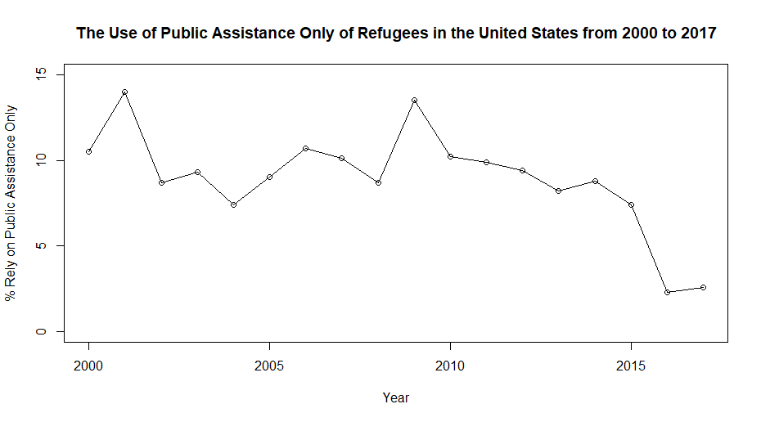
Results: Public Assistance dependence
Notes:
*** Remember that policy changes occur in 2017

Slide 15
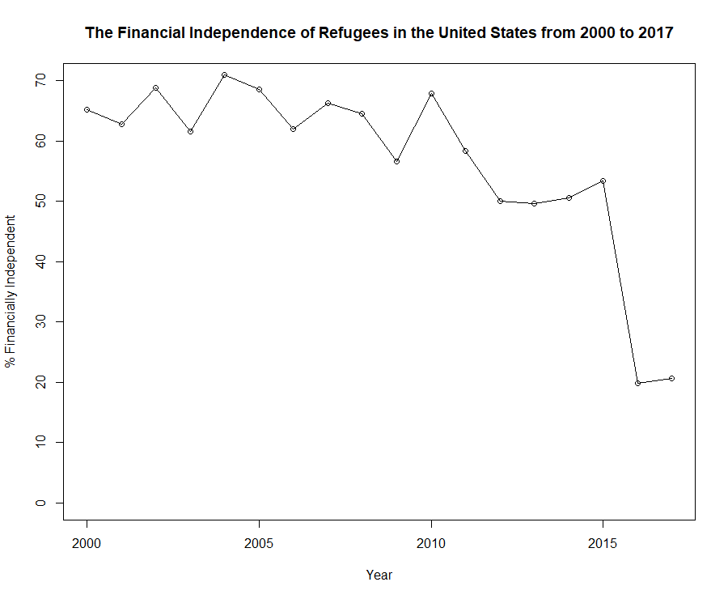
Results: Financial Independence
Chi Square test of independence for 2008-2015: p=.556
For 2000-2015: p=.6335
Chi Square test of independence for 2008-2017: p<.00001
For 2000-2017 p<.00001
Notes:
What do I mean by Obama Era and Trump Era? I would’ve thought I mean from 2008-2016 would be the Obama era and that 2017 would start the Trump Era. But ASR is collected the year after– 2016 data was collected in 2017 and so the stagger can make the hypothesis make sense.

Slide 16
Discussion of findings
The policy changes don’t interact with this time frame.
These findings support the hypotheses

Slide 17
Conclusion
Unlikely that discourse around refugees and immigrants explains the whole 2016 drop.
New directions
Assuming these trends return to previous levels, what structures and initiatives will affect that recovery?
How do disaggregated refugees fare during this time period? Do certain regions of the US have different trends?

Slide 18
pscholes@uncc.edu

Slide 19
Is This measurement error?
The Annual Survey of Refugees goes from a longitudinal to a cross-sectional study in 2016.
The longitudinal design would suffer from attrition, resulting in a oversampling of more recently arrived refugees.
The 2016 survey had a ~25% response rate and the variable had some missing data
I created a fictitious maximum estimate by putting all the missing data against my hypotheses 2000-2017 p=.0019.

Slide 20
Is this measurement error? Continued
Alternative methods to estimate public assistance usage– Capps et al (2015) and Fix, Hooper, and Zong (2017) support the pre-2016 estimates.
The Annual Survey of Refugees went from a longitudinal design to a cross-sectional design in 2016.
Attrition would bias the 1993-2015 samples toward refugees who are LESS financially independent.

Slide 21
What are Phillimore's Opportunity structures?
Initiatives and Support– The programs that assist refugees in their transition: English language programs, job coaching, the refugee non-profits that handle initial resettlement for 5 years.
Locality– Where the refugees are placed: Local environments differ on their ability to meet refugee needs.
Discourse—The conversations that are had about refugees: Refugees (and migrants in the US) have two main stories: Enemy at the Gates or the persevering over all odds story.
Relations– the interactions refugees have with programs and people: Similar to discourse, but focusing on actions toward refugees. In hostile places, refugees report not wanting to leave their homes for fear of their safety.
Structure– the process refugees have to go through to resettle: The US requires refugees to pay their travel costs (an interest free loan). Refugees are only eligible for refugee cash assistance for 8 months.

Slide 22
Are discourse and relations structures in play from 2015-2017?
“Build the Wall”
Trump’s Muslim Ban circa 2015
Trump’s focus on immigration and refugee programs in 2015
(Esses, Medianu, and Lawson 2013)
(Abdulkadir Ali 2017)

